Slide 1
IoT BASED BIDIRECTIONAL VISITOR COUNTER
BVRIT HYDERABAD
College of Engineering for Women
Department Of Information Technology
Team – 5
G Esha(19WH1A1221)
P Preethi(19WH1A1231)
M Harshini(19WH1A1233)
I Harshitha(19WH1A1257)
Under the Guidance of
Guide Name : Mr. Ch. Anil Kumar
Designation : Assistant Professor

Slide 2
AGENDA
Introduction
Existing System
Problem Statement
Literature Survey
Proposed System
Tools & Technology
Feasibility Study
Societal Impact
Project Timeline
Architecture
Modules
UML Diagram
Implementation
References

Slide 3
Introduction
The human counting was unreliable and came at a great cost.
It may be confusing for a person to tally the quantity of individual
entering and leaving at a same time.
Our intension is to design and develop the system to manage human
traffic in a large industry and also conserve the usage of electricity.

Slide 4
Existing System
The present systems are used to count the bidirectional visitor count using the IR sensors and measure the temperature using temperature sensor.
Drawbacks:-
These systems do not measure the humidity of the room and
do not indicate using buzzer.

Slide 5
Problem Statement
Bidirectional visitor counter counts the number of people incoming and outgoing through any large industry and saves electricity based on the requirement using different sensors.

Slide 6
Literature Survey
Title | Author | Journal | Description
IoT Based Smart Assist System to Monitor Entertainment Spots Occupancy and COVID 19 Screening During the Pandemic(2022) | Lakshmi Narayanan, Santhana Krishnan .R, Y.Haro ld Robinson | IEEE | Proposed system will use an IR sensor for counting the people entering and use a MLX90614 IR temperature sensor for screening the public with high temperature.
Automatic Temperature Control System Using Arduino. | Raju, Srujan & Sinha, Professor G. | IEEE | Proposed system will only sense temperature but not humidity.
Design and Construction of a Bidirectional Digital Visitor Counter(2019) | Winfred Adjardjah, George Essien, Hilary Ackar-Arthur | ISSN | Proposed system will count visitors effectively by reducing the rate at which error occurs when Counting visitors.

Slide 7
Proposed System
In our proposed model we use IR sensor and DHT11 sensor.
We use a buzzer to indicate that the temperature of the room exceeded the limit.
This model is also used to conserve electricity by automatically turning the devices
on/off.
We will use an Arduino (microcontroller) to implement this system.

Slide 8
Tools and Technology
Environment | Specifications
Hardware | Arduino Uno Board , LCD Display , IR sensor, DHT11 sensor , Buzzer , Power Supply
Software | C language, Arduino IDE Environment

Slide 9
Feasibility Study
IR sensors will count the numbers of guests and automatically run the lights and fans accordingly.
DHT11 sensors is used as the temperature and humidity sensor to output the values of temperature and humidity as serial data.
Buzzer to notify when the limit of the number of people exceeds.

Slide 10
Societal Impact
Our model helps in saving the time by avoiding manually counting the
number of people are entering and exiting.
It also helps in saving the electricity which is very useful in many sectors.
It can be implemented in cinema halls, multiplex, shopping malls as
well as in temples to count the no. of people entering inside. So that
these places should not get over crowded to avoid conjestion.

Slide 11
Project Timeline
Dates(To-From) | Duration | Tasks
06.09.2022-22.10.2022 | 4 weeks | Domain Selection References Specifications Requirements
23.10.2022-12.11.2022 | 3 weeks | Literature Survey
13.11.2022-18.12.2022 | 5 weeks | Partial implementation
19.12.2022-10.01.2023 | 3 weeks | Full Implementation

Slide 12
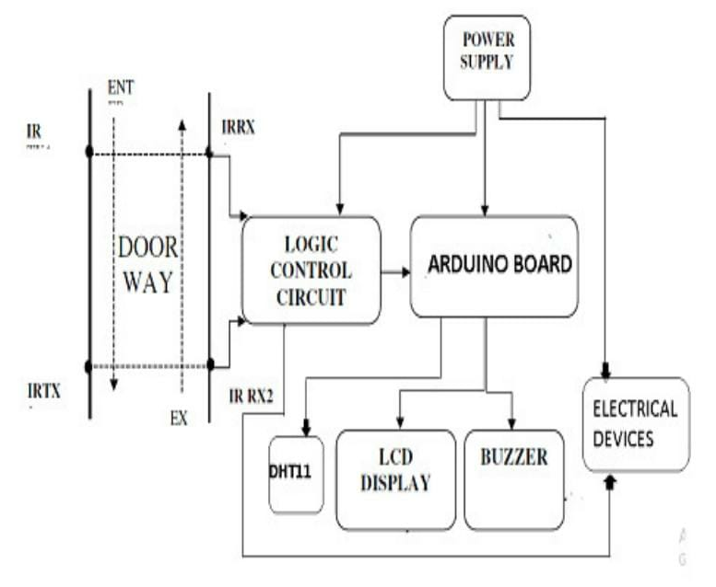
Architecture

Slide 13
Modules
Counting the persons entering and exiting the room.
Automatic on & off of lights and fans based on the
number of persons .
Checking the temperature & humidity.

Slide 14
UML Diagram
start
Send pulse to microcontroller
DHT sensor
Person entering
Check for pulse byte
More than 50 C*
Get IR sensors read
Microcontroller inc count by 1
Microcontroller dec count by 1
Value initialize to zero
Initialize sys bus
Initialize sys bus
Turn off buzzer
Turn on buzzer
Person tends to cross IR lines
LCD Display
Is IR lines breaks off
Send data to segment

Slide 15
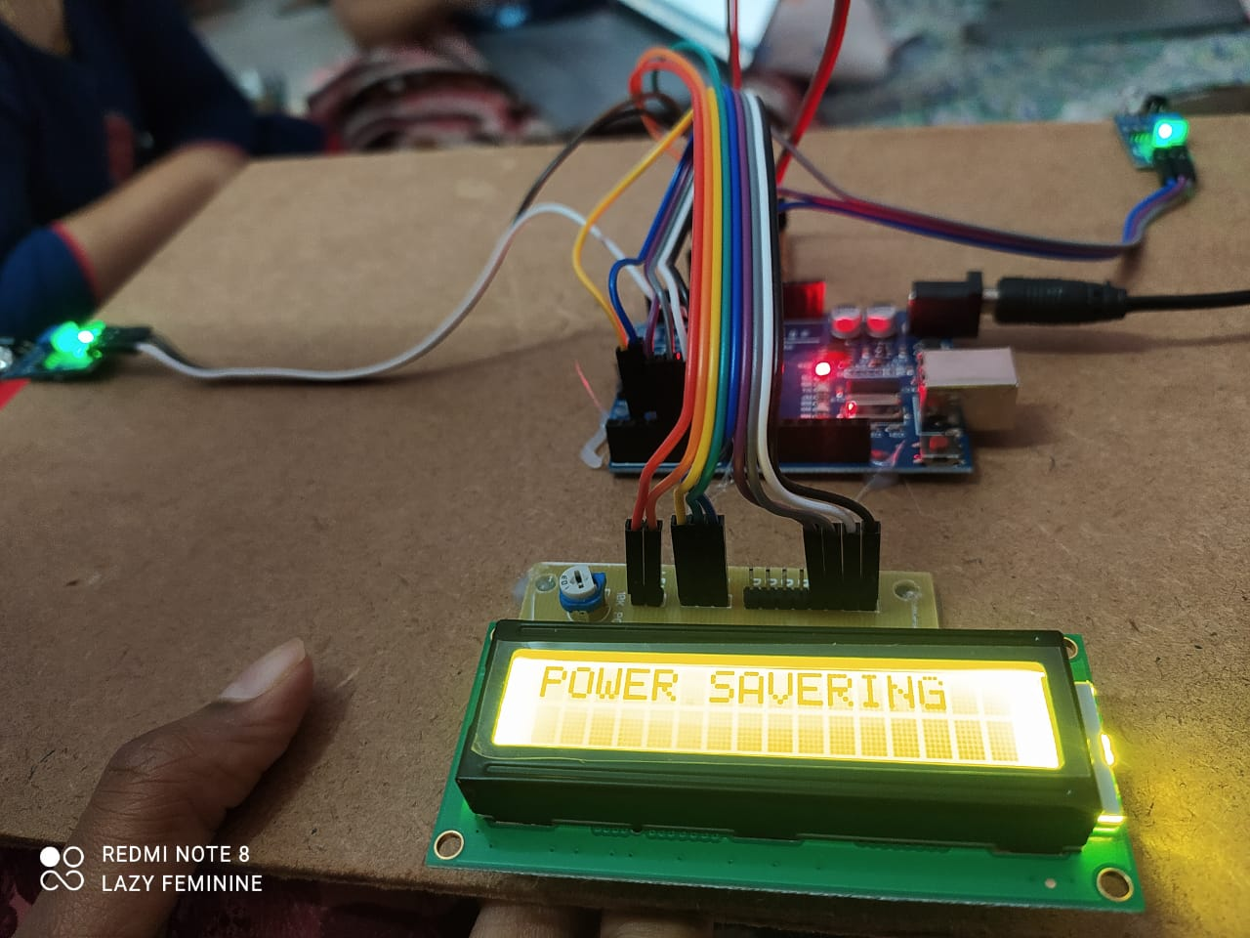
Implementation
Fig- 1: Image is displayed when power supply is given

Slide 16
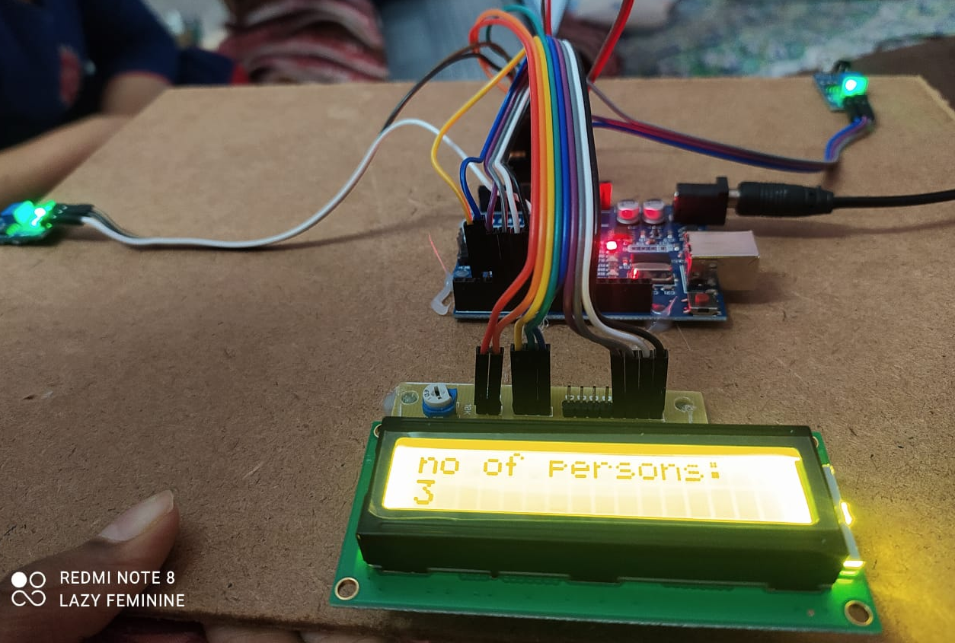
Fig-2: When people enter the room,
the count is shown as above

Slide 17
References
Narayanan, K.L., Krishnan, R.S. & Robinson, Y.H. “IoT Based Smart Assist System to Monitor Entertainment Spots Occupancy and COVID 19 Screening During the Pandemic”. IEEE(2022).
Raju, Srujan & Sinha, Professor G. “Automatic Temperature Control System Using Arduino”. IEEE(2020).
Winfred Adjardjah , George Essien, Hilary Ackar - Arthur, “Design and Construction of a Bidirectional Digital Visitor Counter ”, ISSN(2019).

Slide 18
THANK YOU

